Slide 1
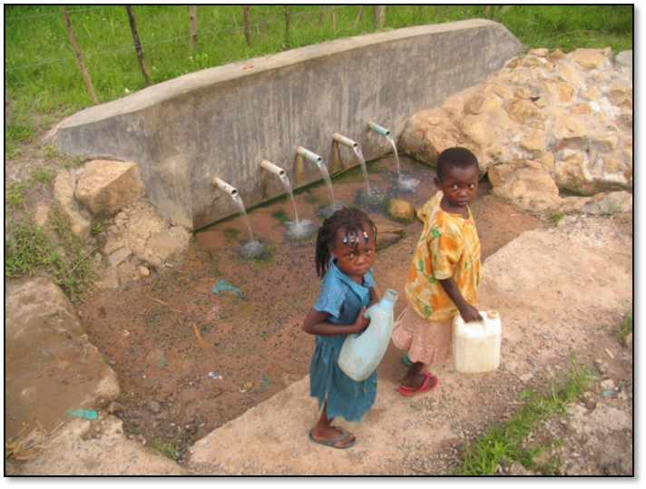
Sanitation Marketers Training
Urban Low Income Areas & WSS Situation

Slide 2
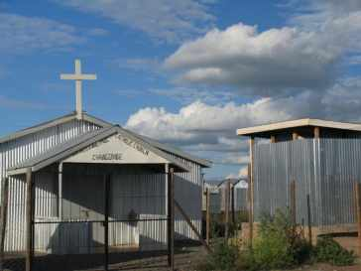
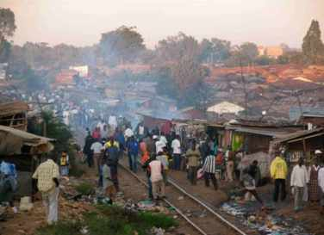
What are the target areas of the UBSUP/SafiSan Programme?
Informal urban settlements
Informal settlements are often referred to as “urban slums”
Residents often depend on a small number of house/yard connections, springs and wells
In other areas residents use water kiosks or rely on the services of water resellers
Households residing on the same plot share pit latrines and in slums (such as Kibera in Nairobi) some residents resort to flying toilets

Slide 3
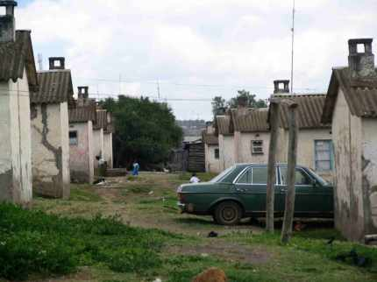
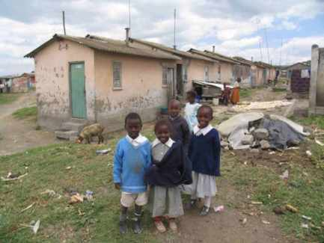
2. Target areas: Planned urban areas with planned low income housing
Planned low income housing areas or estates with high population densities, dilapidated water supply and sanitation systems (e.g. Council and Government housing areas)

Slide 4
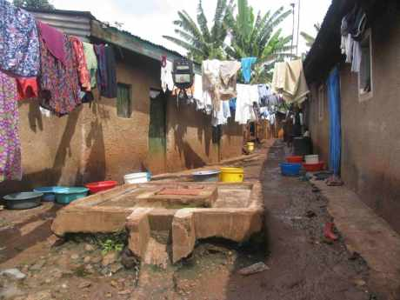
3. Target Areas: Informal housing in planned residential areas
Informal housing in planned urban areas where plot owners have title deeds
Sometimes plots with informal housing constitute small pockets which are surrounded by well constructed homes or commercial properties
Flats in Kitale >>

Slide 5
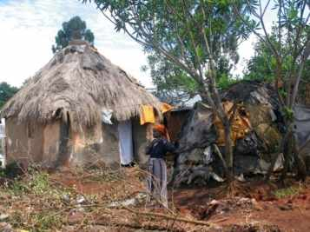
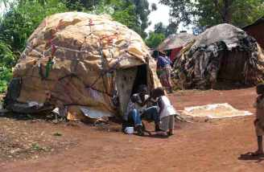
4. Target Areas: Urban IDP settlements
In some towns such as Kitale, there are a number of well established IDP settlements
These settlements are characterised by high population densities and informal housing (houses and huts constructed with branches, plastics and other available materials)
Income levels in these settlements are usually very low and the WSS situation is often poor

Slide 6
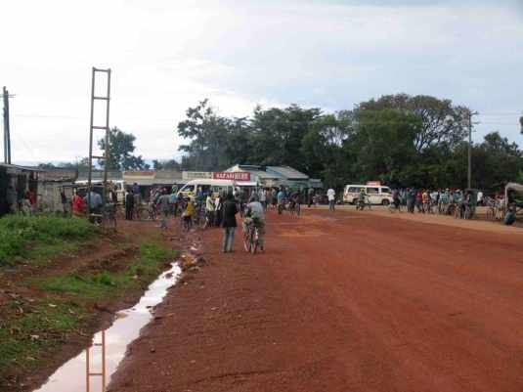
5. Target areas: Urban sub-centres
An urban sub-centre can be described as a relatively small urban centre, which is often situated at some distance from the nearest main town
Bukembe near Bungoma >>

Slide 7
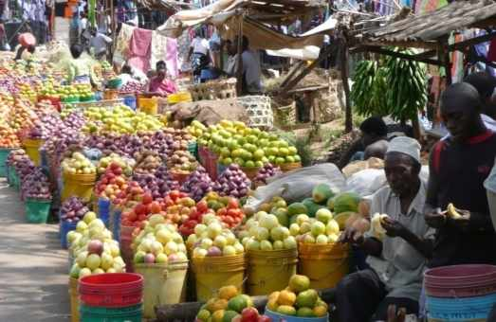
6. Target areas: Large rural centres with urban characteristics
A large rural centre can be described as a large settlement located in a rural setting
Population size and population density render rural water supply solutions (hand pumps, etc.) unsuitable

Slide 8
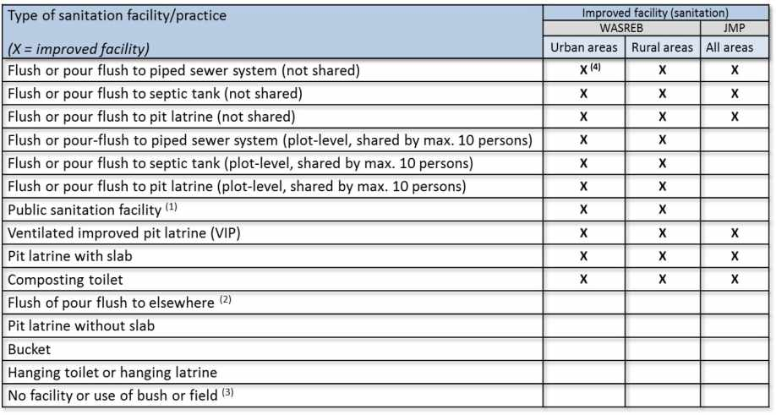
What is improved sanitation?
Notes:
1): Only an improved sanitation facility in certain urban settings such as urban slums with very high population densities
2): E.g. excreta are flushed to the street, yard or plot, open sewer, a ditch, a drainage way or other location
3): In rural areas with very low population densities open defecation or “cat system” defecation may not pose a risk to public health and to the environment.

Slide 9
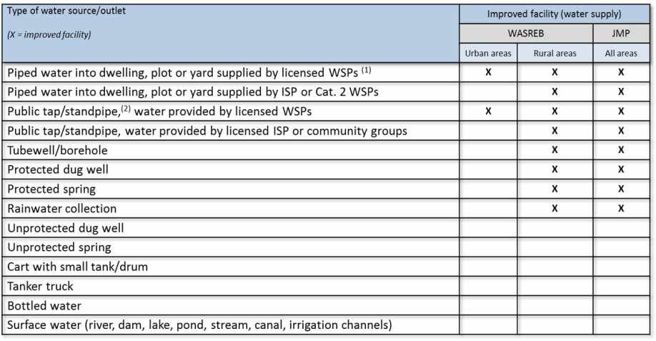
Water Supply and Sanitation in the Target Areas

Slide 10
Habitation Patterns in Low Income Areas
The WSTF and GIZ carried out a sanitation study in 11 cities and towns (+- 2,000 households were interviewed
This UBSUP Preparatory Study shows:
A large majority (63.9%) of all households in the low income areas studied
are renting their accommodation

Slide 11
Habitation Patterns in Low Income Areas
The study also shows that there are marked differences between the various cities and towns
In Nakuru and Kiserian, approximately 90% of all households are renting their accommodation - Figures for Garissa and Isiolo are much lower; 14.3% and 28.6% respectively
Approximately 37% of all plot owners are residing on the plot (resident landlord and landlady) while 35 % of the landlords or landladies are not residing on the plot

Slide 12
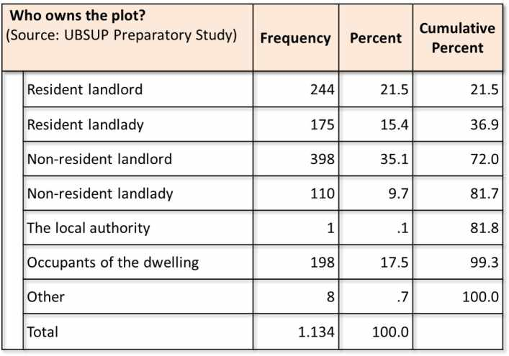
Habitation Patterns in Low Income Areas

Slide 13
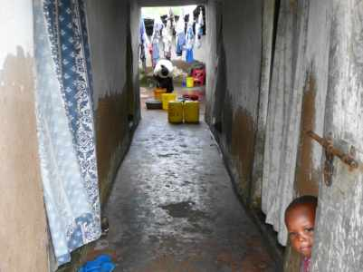
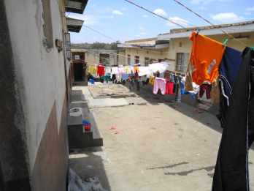
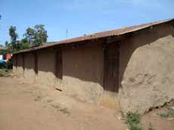
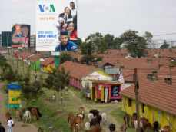
Habitation Patterns in Low Income Areas (Examples)

Slide 14
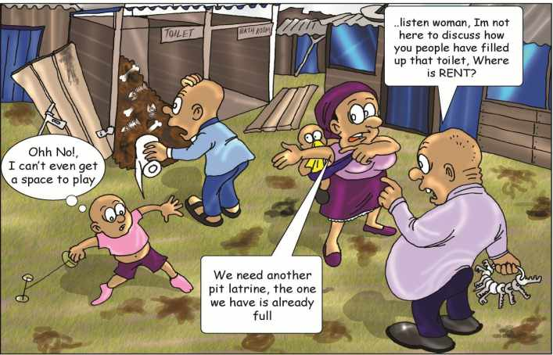
Sanitation in Low Income Areas
Landlords & landladies play an important role in decision making with regard to sanitation

Slide 15
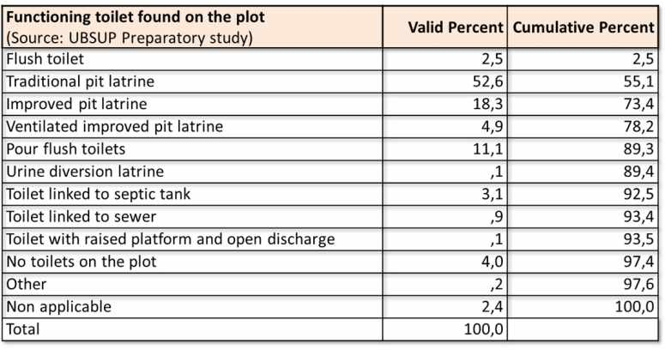
Sanitation Situation in Low Income Areas
Low income areas: The traditional pit latrine is the most common toilet, followed by the improved pit latrine
Only 4% of the residents of all plots do not have a functioning toilet

Slide 16
Sanitation Situation in Low Income Areas (Cont’d)
Most households must share the toilet they use with other households living on the same plot
However, almost no households that have their own toilet share their toilet with others (e.g. other families residing on the same plot)

Slide 17
Sanitation Situation in Low Income Areas (Cont’d)
36.2% of Muslim households have their own toilet. This is significantly higher as compared to Christian households (15.4%) (Source: UBSUP Preparatory Study)
This is understandable if one considers the emphasis placed by Muslims on:
gender and privacy
their preference for squatting instead of sitting (for hygienic reasons),
the use of water for anal cleansing and
their preference for pour-flush toilets

Slide 18
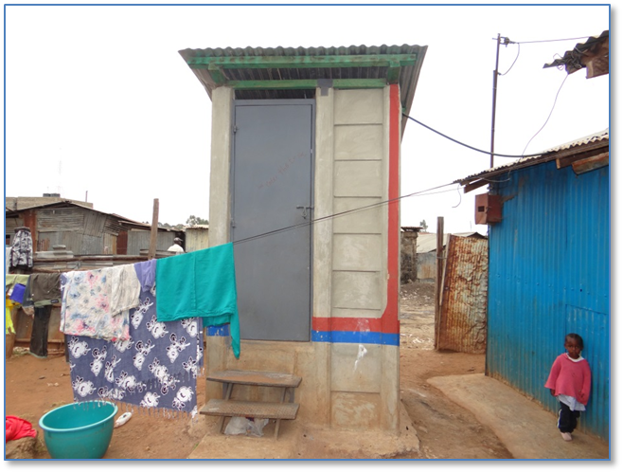
Thank you!

